Slide 1

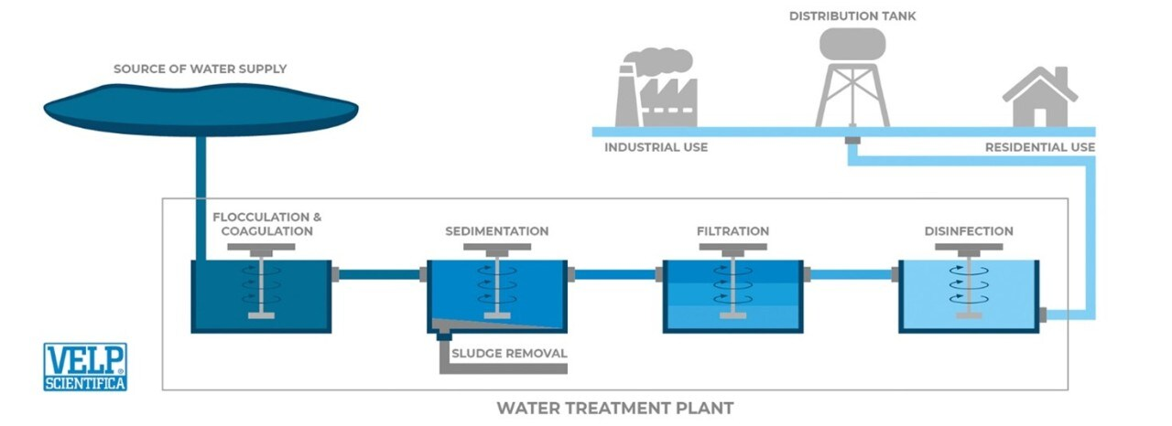
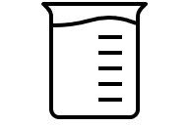

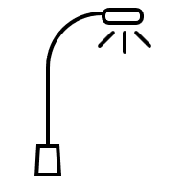
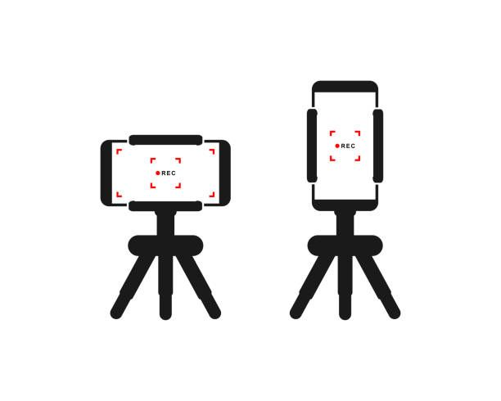
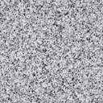
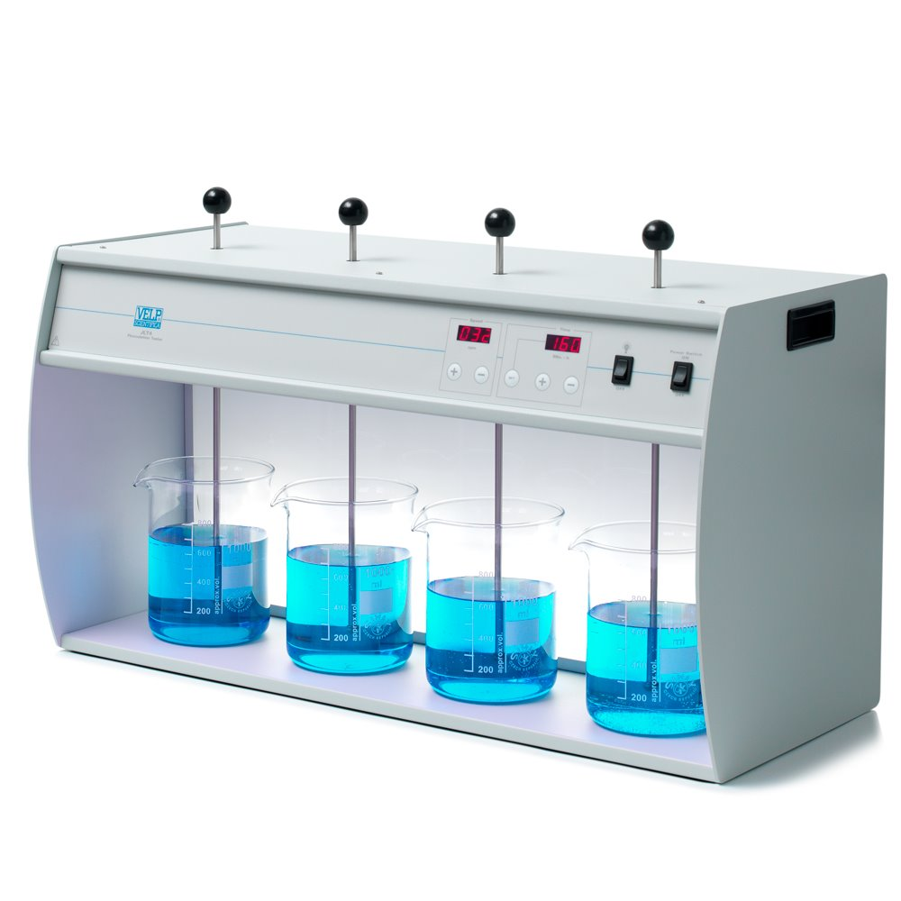
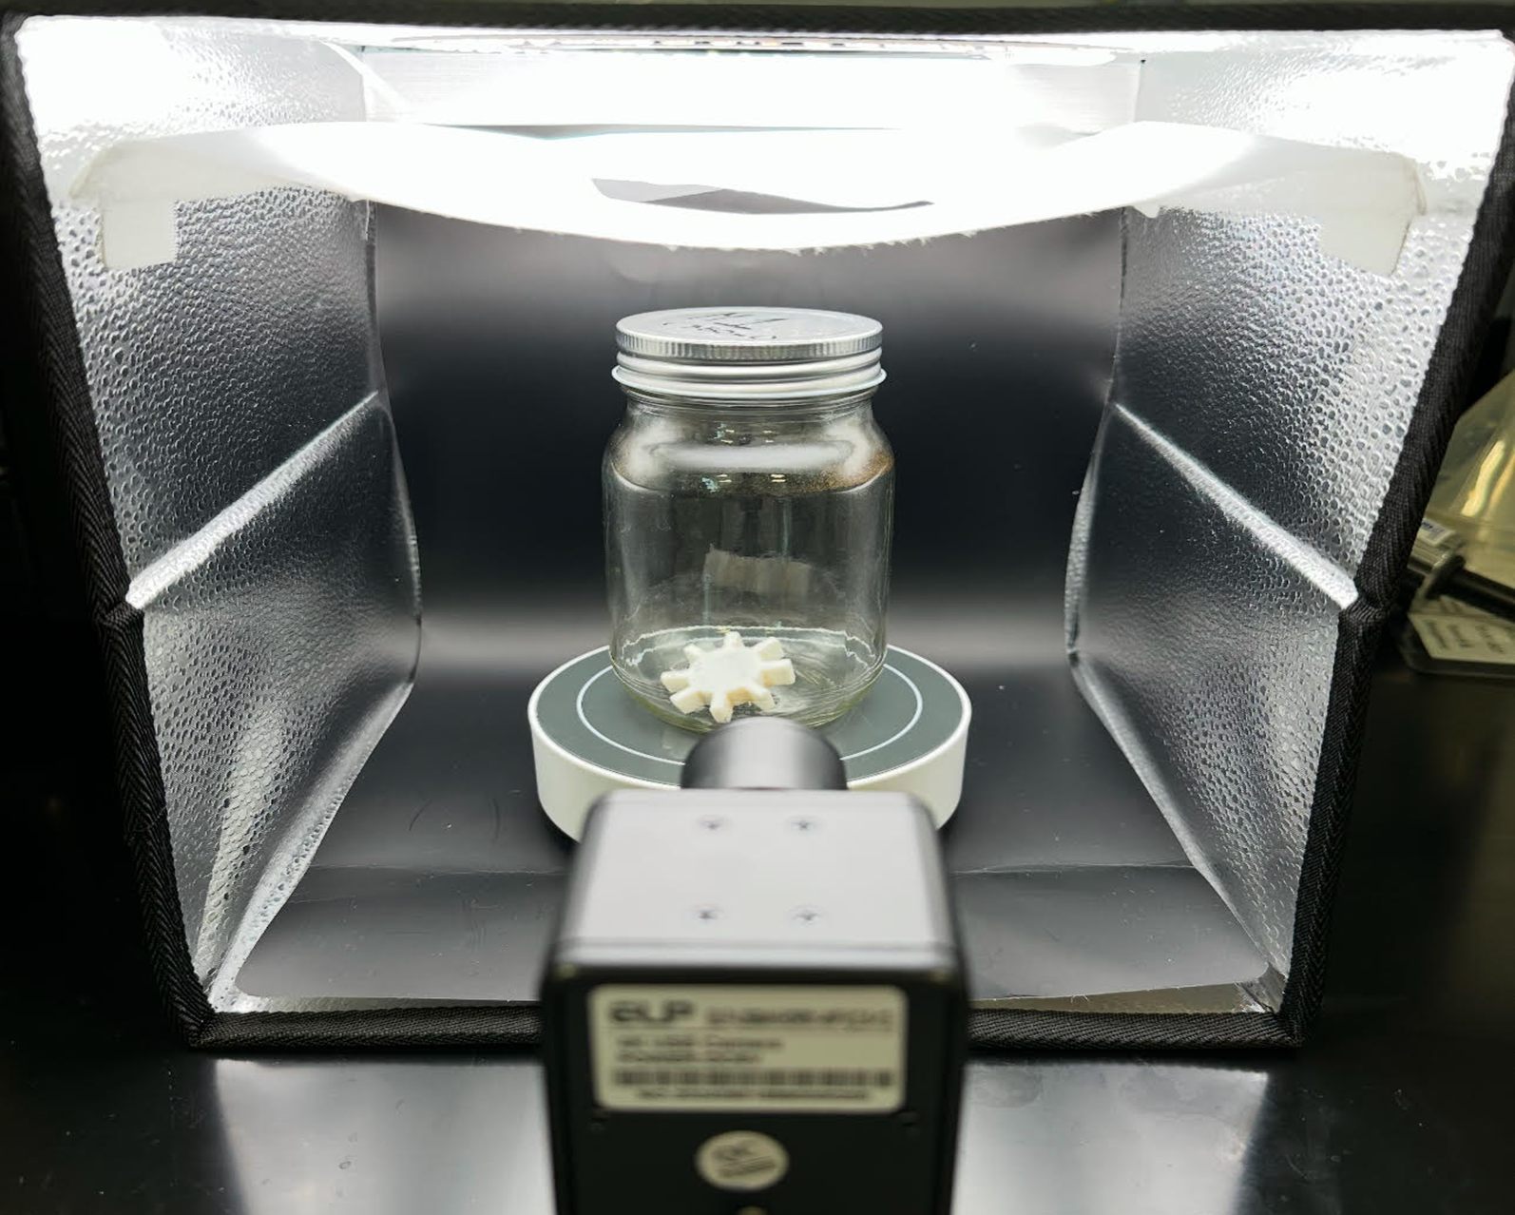
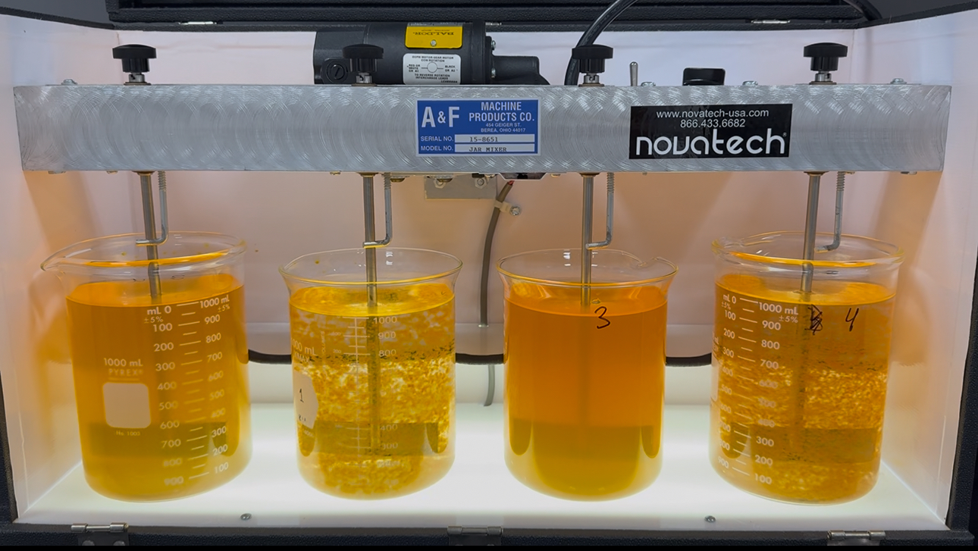
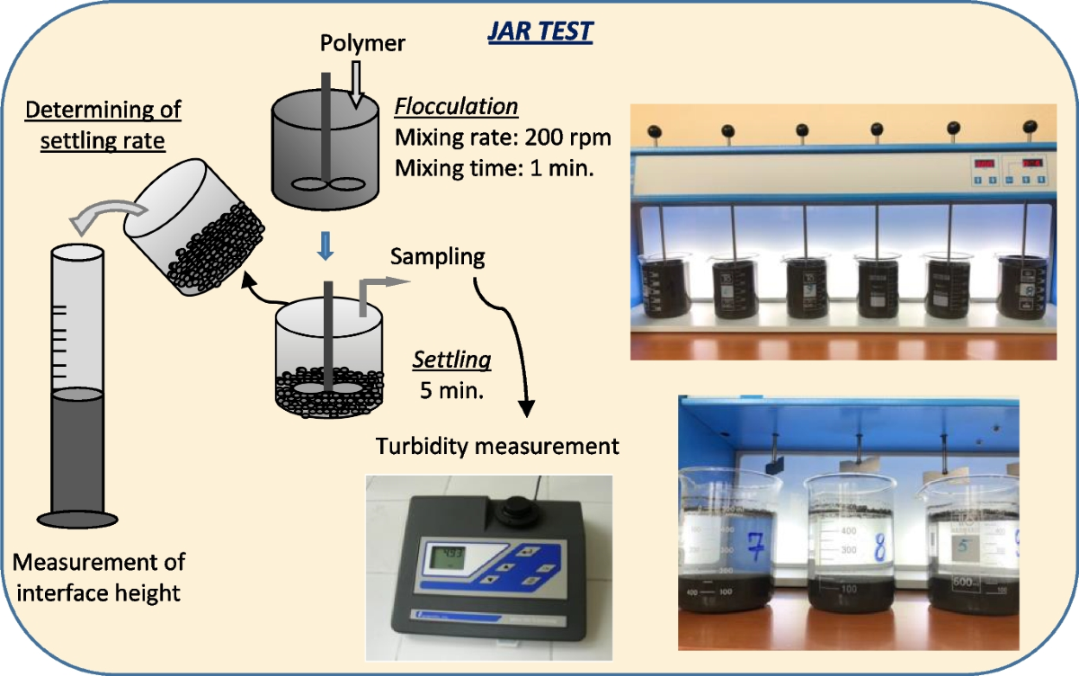





26-608
Vision-Based Settling Rate Analysis for Water Treatment
Team members: Aubrey Carey, Virginia Anderson, Ronald Menendez, Rohan Sharma | Faculty adviser: Charles McGill, Ph.D., Bridget McInnes, Ph.D. | Partner: ChemTreat | Mentor: Vladimir Djukanovic
Background
Concept Evaluation
Design Details/Specifications
Water treatment relies on the effective removal of suspended solids and other contaminants to ensure water quality and safety. The first critical step in water treatment is the addition of coagulants to bind suspended particles in raw water to form conductedddddd
Novatech AFM-JM-4 apparatus was modified for this project
Phone stand attached to rig for consistent camera position
Back stopper was raised to allow backlighting
Nonslip bottom added to improve jar stability
Video captures at 30 FPS with auto-cropping capabilities
Overall dimensions were 23” x 9” x 16.25”
larger flocs, accelerating their settling and removal. Due to the wide variety of coagulants that are available, tests must be conducted to
identify the best coagulant for each water treatment process.
Design A | Design B | Design C
Pros Most control over dimensions (portability) Smaller water samples required | Pros Most familiar Cost effective (existing equipment) Fewest modification and most robust | Pros Removable modifications Controls for the most variables Strongest signal for mean-intensity turbidity
Cons Least robust Unfamiliar Poor mixing (manual) | Cons Lighting issues Camera misalignment (poor for model training) | Cons Least portable Modified to specific apparatus
Worst | Middle | Best
Cost Analysis
Equipment |  | Price
*Mini-Jar Apparatus |  | $4800
Lighting Modifications |  | $40
Camera Positioning Control |  | $30
Jars best for Model |  | $25
Surface Modifications |  | $25
Camera to computer (data collection) |  | $10
*assumed possession of phone camera |  | *$700
Total w/o Apparatus | Total w Apparatus | Total w/ Phone
$130 | $4920 | $5620
Existing Solutions
Jar Tests
(Current Industry Standard)
Jar Test using ML model
(Previous Capstone Project)
Design Methodology
Jar testing relies on manual observation which introduces variability and limits portability. There is a growing need for automated, on-site testing to improve accuracy and speed in water treatment. Our team is developing a portable, computer vision-based apparatus using machine learning to quantify settling rates, building on a previous prototype while improving mobility and enabling comparison of multiple samples.
Computational
Complete by comparing the system’s automated measurements to manual results and standard turbidity readings.
Design and Future Work
OpenCV - image processing
TensorFlow - overall model development
Video frame is processed through background subtraction and settling curve generation to accurately quantify the settling behavior
After evaluating multiple configurations, the fixed camera with LED back-lighting proved the most effective; offering higher accuracy, portability, and consistent results with relatively simple construction.
Future work
Conduct jar tests to collect training data for the CNN
Refine lighting and calibration curve to ensure differences between jar positions has minimal impact on testing results
Tune the CNN model for higher prediction accuracy
Confirm structural robustness and determine the effect of jar position on computation and create a calibration curve
Validation
Design Specifications
Improve how settling performance is assessed during jar tests and pilot runs
Experimental
Acknowledgements & References
Standardization
Make automated and objective settling measurements in real-time
Portability
Develop a portable testing apparatus to be used on a job site for real-time results
Speed & Efficiency
Reduce test time by increasing number of jars that can be run at once
We sincerely thank ChemTreat for their support and collaboration on this project.
Design Details
Experimental Methods
Backlighting reduces glare and shadowing. Modifying the jar test apparatus improves durability and data capture. A fixed phone stand ensures consistent camera angles.
[1] Fisher Scientific. (2023). The importance of jar testing in water and wastewater analysis. Lab Reporter. Retrieved October 6, 2025. https://www.fishersci.com/us/en/scientific-products/publications/lab-reporter/2023/issue-3/the-importance-of-jar-testing-in-water-and-wastewater-analysis.html
[2] Satterfield, Z. (n.d.). Jar testing (National Environmental Services Center). Retrieved October 6, 2025. https://actat.wvu.edu/files/d/3cf372e5-ba40-450c-a3ad-cd774f4c3345/jar-testing.pdf
[3] Flocculators / Jar Tester. VNK Supply & Services. (n.d.). https://vnk.com.my/product/flocculators-jar-tester/
[4] Amarjargal, B., & Ta&#351;demir, T. (2023, August 24). A comparative study: Evaluation of wastewater suspensions flocculation performance using laboratory graduated cylinder and jar test methods - water, air, & soil pollution. SpringerLink. https://link.springer.com/article/10.1007/s11270-023-06605-0
Requirements: Model should be compatible with iPhone products
Computational & Validation Methods
Settling curves and clarity plots will be generated from 30 FPS video data with pixel intensity indicating settling rate. Consistent camera positioning and LED backlighting ensure reliable measurements
Notes:
Add ChemTreat logo
Instead of clumps use flocs

